Slide 1
Новые книги на английском языке

Slide 2
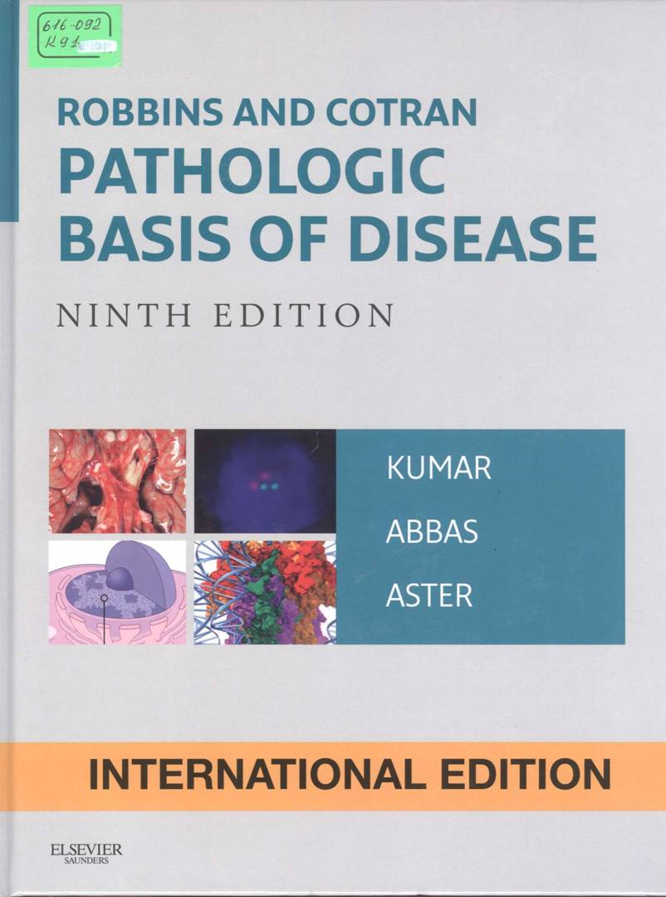
Тhis book provides the latest, most important knowledge in the field of pathology in a readable and interesting way, providing an optimal understanding of the latest fundamental scientific and clinical materials. Hi qt-quality photos and full – color illustrations reflect new information in the field of molecular biology, classification of diseases new drugs and treatments, and much more.
616-092
K 91
Kumar , V. Robbins and Cotran. Pathologic Basis of Disease : V. Kumar , Abyl K. Abbas, Jon C. Aster. - 9 nd ed. - [S. l.] : Elsevier/ Saunders , 2015.

Slide 3
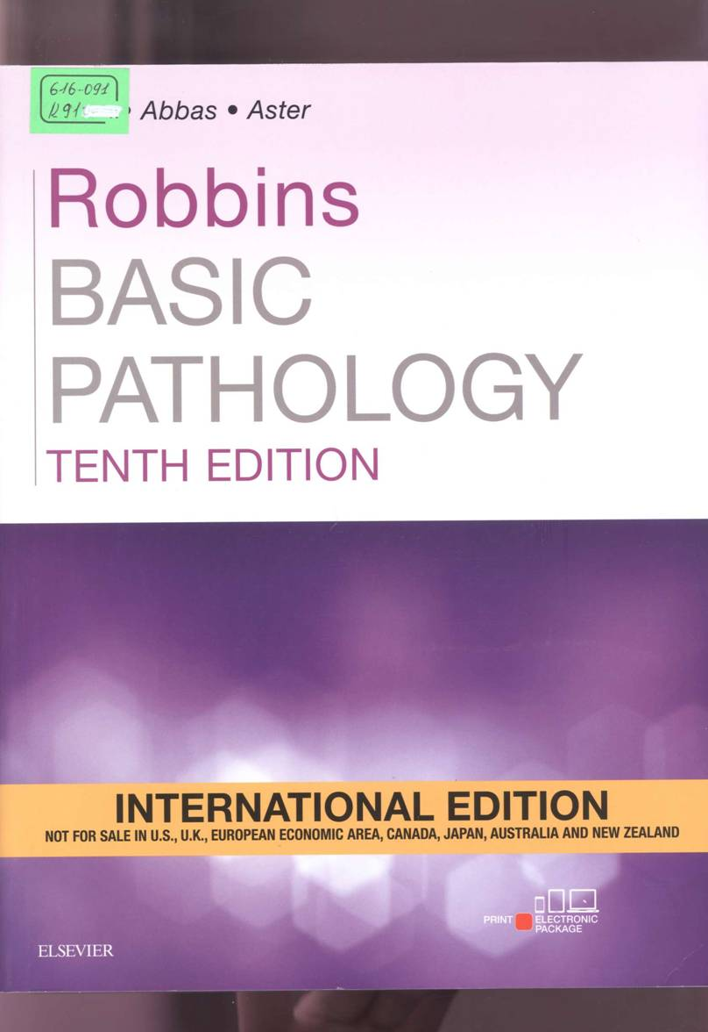
This book provides a readable, well-illustrated and concise overview of the principles of human pathology, which is ideal for today’s busy students. This carefully revised edition with a strong focus on pathogenesis and clinical signs of the disease, adding new artwork and more schematic diagrams to further assist in summarizing the underlying pathological processes and expand the already impressive illustrative program.
616-091
К 91
Kumar , V. Robbins Basic Pathology : V. Kumar , A. K. Abbas, J. C. Aster. - 10 nd ed. - : Elsevier, 2018

Slide 4
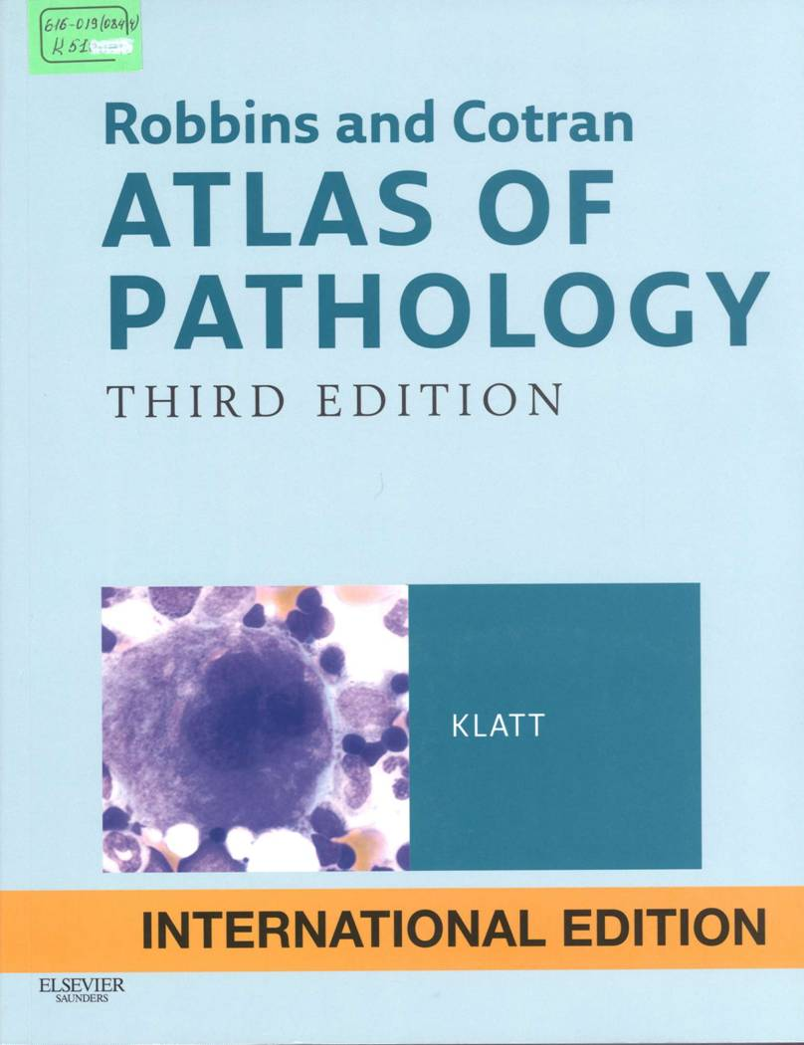
This book is the eighth edition of one of the popular medical text books in the world. It contains modern knowledge of pathology presented in full by leading experts in this field reveals the basic concepts in a simple form provides the reader witch information about the pathological foundations of diseases with clinical and morphological compressions including on the basic of the latest achievements of cellular and molecular biology. As in previous editions unresolved issues are discussed in detail to engage the reader in the search for answers .This edition has been revised and supplemented with more than 1600 color photographical drawings and tables which simplifies the development of the materials. The book is intended for students of medical schools and for practitioners.
  616-019(084.4)
  К 51
  Klatt, Edward C Robbins and Cotran Atlas of Pathology : textbook / Edward C. Klatt. - 3th ed. - Philadelphia : Elsevier Saunders, 2014.

Slide 5
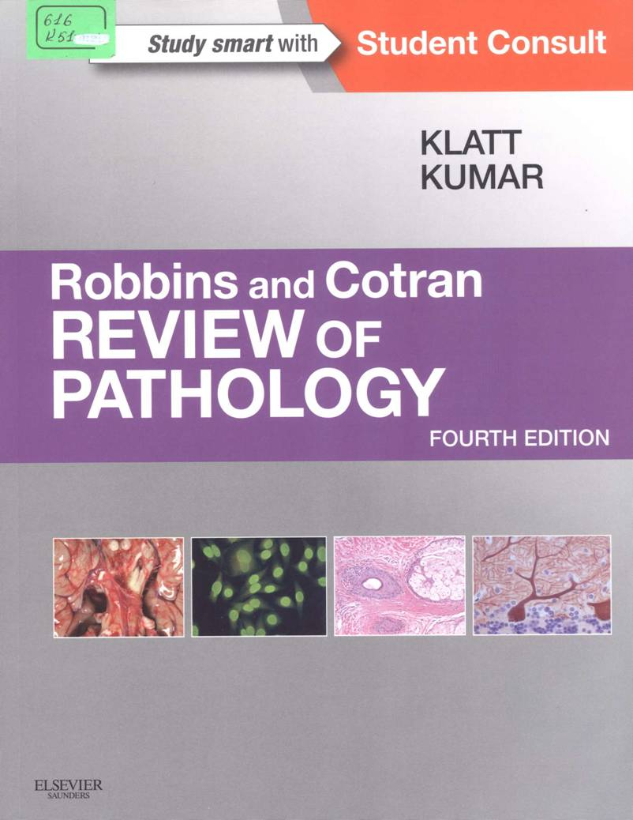
This book shows the most important knowledge in the field of pathology in a readable and interesting way, providing an optimal understanding of the latest fundamental scientific and clinical materials. High-quality photos and full-color illustration reflect new information in the field of molecular biology, classification of diseases, new drugs and treatment and much more.
  616 K 61
  Klatt , Edward C. Robbins and Cotran. Review of Pathology [Edward C. Klatt , V. Kumar . - 4 nd ed.: Elsevier Saunders, 2015.

Slide 6
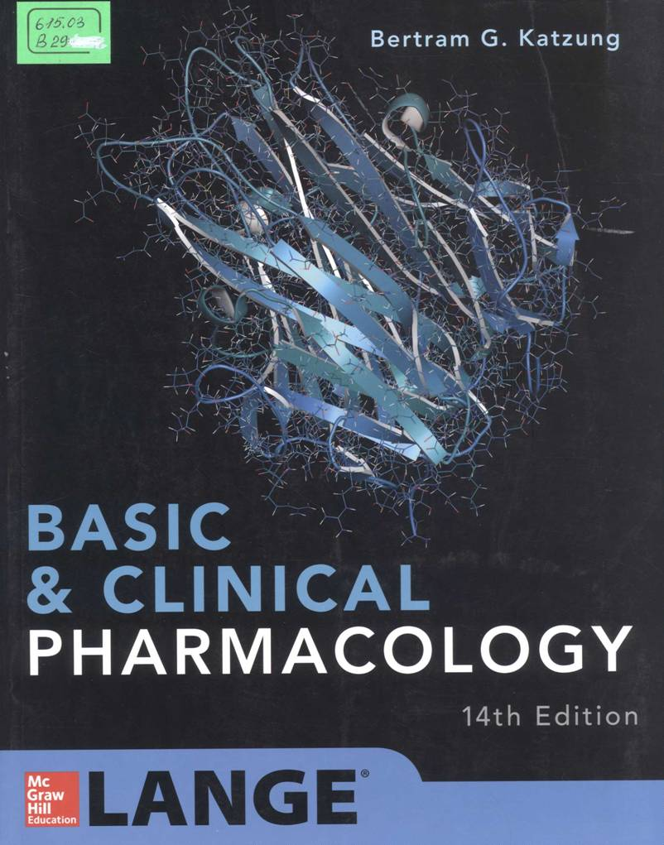
This edition continues the sequence used in many pharmacology courses and in integrated curricula: basic principles of drug discovery, pharmaco-dinamics, pharmacokinetics and pharmaco-genomics; autonomic drugs; cardiovascular-renal drugs, drugs with important action on smooth muscle; drugs of the central nervous system; drug used to treat inflammation, gout and disease of the blood; endocrine drugs; chemotherapeutic drugs; toxicology and special topics. This sequence build new information on the basis of information already learnt.
  615.03
  B 29
  Katzung , Bertram G. Basic and Clinical Pharmacology / Katzung Bertram G. - 14 nd ed. - [S. l.] : McGraw-Hill education, 2018.

Slide 7
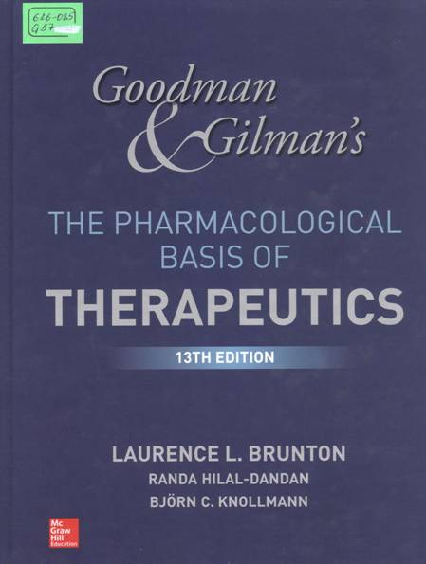
This book is the pinnacle of authority and accuracy in describing the action and use of therapeutic agents in relation to physiology and pathophysiology. Enriched with a new full-color presentation to reflect all major new developments in the field of drug action and interaction between drugs and diseases includes more than 500 color illustration, many new figures highlight the mechanisms of drug action. More than 30 new members have added to this edition, while the focus is on the basic principles.
616-085
G 57
Goodman end Gilman's , A. The Pharmacological Basis of Therapeutics / Goodman & Gilman's A. ; editor L. L. Brunton . - 13 nd ed. - New York : McGraw-Hill Education, 2018.

Slide 8
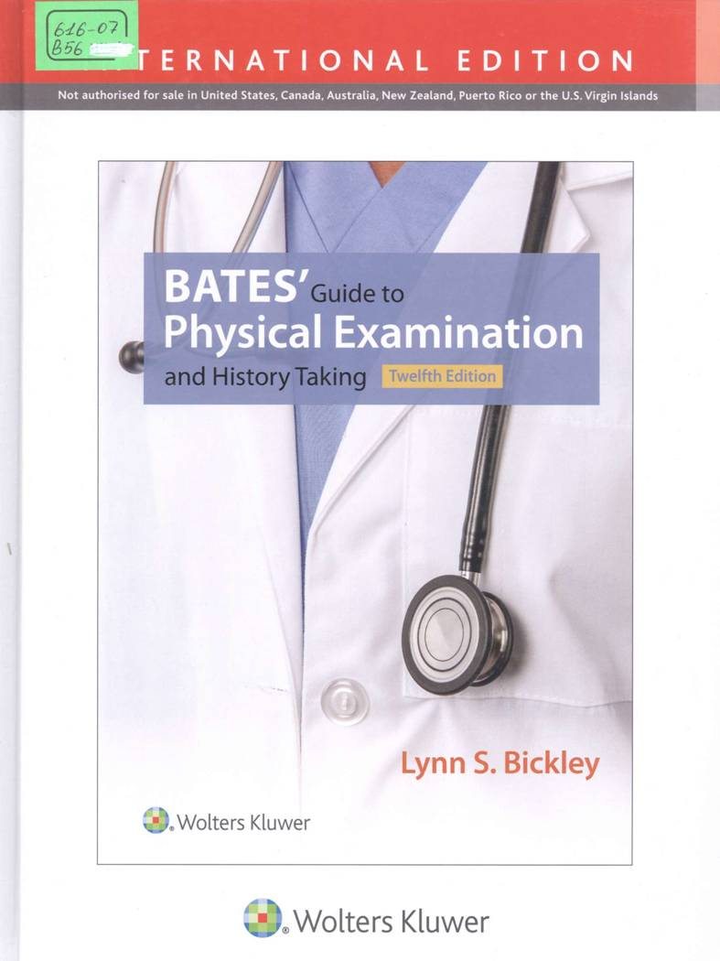
The sings and symptoms that patients face are often a mystery to the examiners. This course allows you to perform key examination methods and correctly assess all relevant organ symptoms, increasing the likelihood of correct diagnosis. In addition to student and specialists in the field of medicine and health care, everyone is invited. Collecting stories is an important part of the exam process. This course teaches the skills needed to select the appropriate questions. In addition, the course will discuss how to build a reliable interaction between the patient and the doctor.
  616-07 B 56
  Bickley , L. S. Bates' Guide to Physical Examination and History Taking / L. S. Bickley , Szilagyi P. G., R. M. Hoffman. - 12 nd ed. - Philadelphia : Wolters Kluwer , 2017.

Slide 9
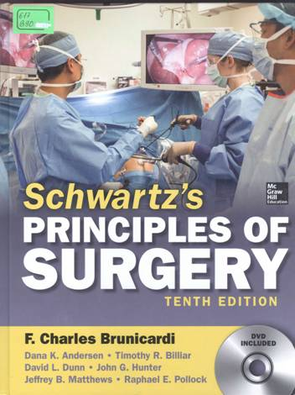
It provides unrivalled coverage of the book basics of surgery while at the same time attracting to a clearer focus new and new technologies. We have entered a new era of surgery in which minimally invasive surgery and the use of computers and genomic information have improved patient outcomes and quality of life. With these advances all chapters have been updated with a focus on evidence– based modern surgical care .An exciting new chapter, “fundamental principles of teaching leadership in surgery;” extend the book beyond the operating room to cover the actual development of surgeon. More than ever, the principles of Schwartz surgery are international in scope – a collection of knowledge and techniques of the word s leading surgeons.
  617
  B 90
  Brunicardi, F. Charles Schwartz's principles of surgery / F. Charles Brunicardi. - 10 nd ed. - [S. l.] : McGraw-Hill Elucation, 2015.

Slide 10
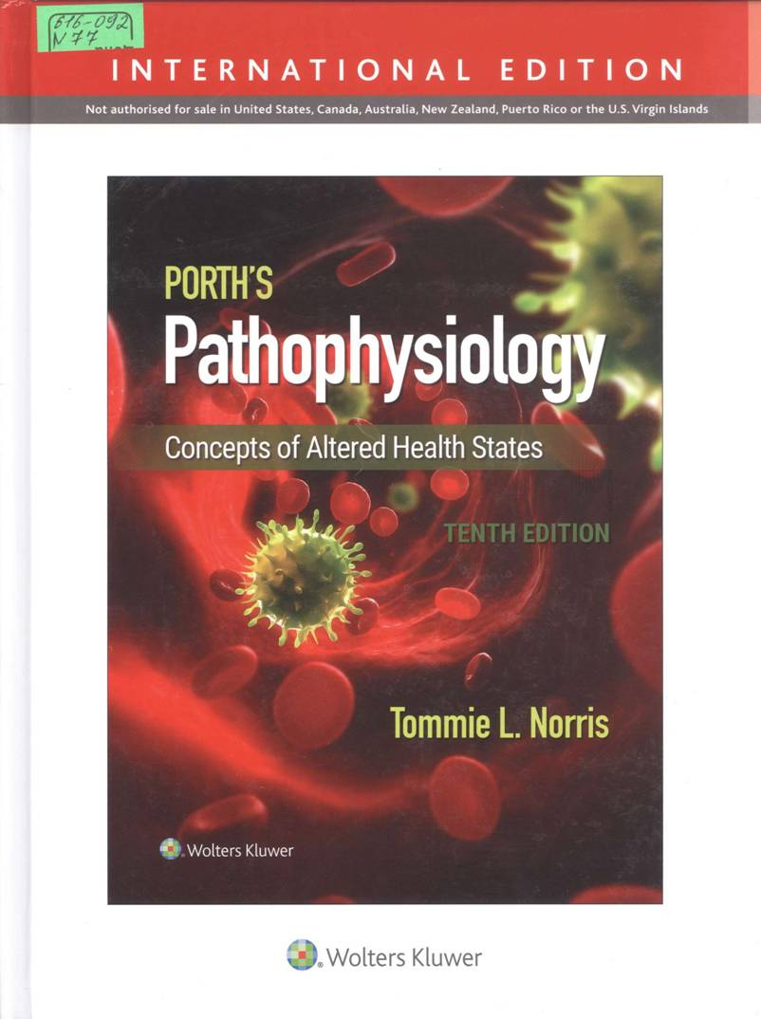
This fascinating and easy to understand, proven book contain comprehensive nurse-centered information that will help you understand both the physical and psychological aspects of altered health. Help to master clinically relevant and difficult to understand disorder through advanced 3D animation. The book has 14 case studies on the opening of department that really reflect pathophysiology and help you relate the clinical picture to the underlying the pathophysiology. It help you to find the information you need with a consistent presentation of the book for each disease, with a detailed description of pathophysiology, clinical manifestation, as well as evaluation and treatment.
  616-092 N 77
  Norris, Tommie L. Porth's Pathophysiology: Concepts of Altered Health States / T. L. Norris . - 10 nd ed. - [S. l.] : Wolters Kluwer, 2019.

Slide 11
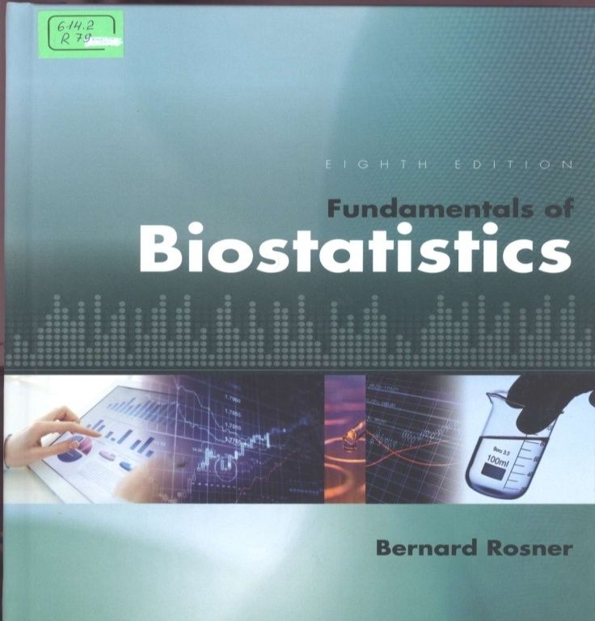
This book includes a practical introduction to methods, techniques and calculating statistics for people. It prepares students for future and careers by presenting statistical techniques most commonly used in the medical literature. B.Rosner minimizes the number of mathematical formulations (based on algebra), while giving complete explanations of all important concept. The main strength of this book is that each new concept is developed systematically based on fully development examples from current medical research problems. Most methods are illustrated with specific implementation instruction using software from SAS, State, Excel or Minitab.
  614.2 R 79
  Rosner, Bernard
  Fundamentals of Biostatistics / B. Rosner. - 8 nd ed. - [S. l.] : GENGAGE learning , 2016.

Slide 12
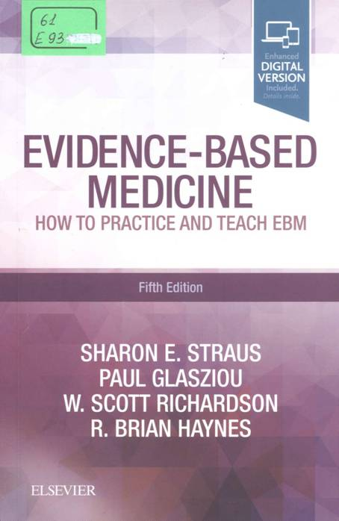
Now in its fifth edition, this classic introduction to the practice and teaching of evidence-based medicine is written for busy clinicians at any stage of their careers who want to learn how to practice and teach evidence-based medicine (DM). This is a short and practical guide that highlight the direct clinical application of EBM and tactics to practice and teach in real time.
  61 E 93
  Evidence - Based Medicine how to practice and teach / S. E. Straus and other. - 4 th ed. - Edinburgh : Elsevier, 2019.

