Slide 1
Новые поступления литературы на английском языке
New entry of literature in English
Ағылшын тіліндегі жаңа әдебиеттер
25.01.2018 г.

Slide 2
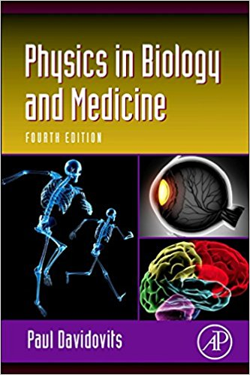
Physics in Biology and Medicine, Fourth Edition, covers topics in physics as they apply to the life sciences, specifically medicine, physiology, nursing and other applied health fields. This is a concise introductory paperback that provides practical techniques for applying knowledge of physics to the study of living systems and presents material in a straightforward manner requiring very little background in physics or biology. Applicable courses are Biophysics and Applied Physics.
  53
  D11
  Davidovits, P. Physics In Biology And Medicine : P. Davidovits. - 4th Ed. - Philadelphia : Elsevier, 2013.

Slide 3
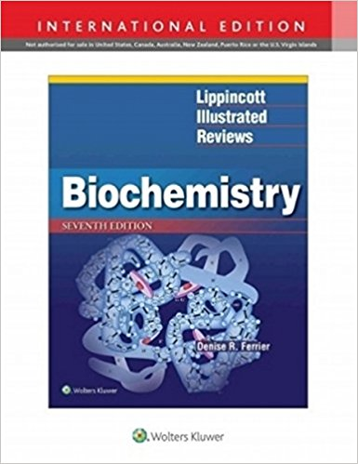
Lippincott Illustrated Reviews: Biochemistry Is The Long-established, First-and-best Resource For The Essentials Of Biochemistry. Students Rely On This Text To Help Them Quickly Review, Assimilate, And Integrate Large Amounts Of Critical And Complex Information. For More Than Two Decades, Faculty And Students Have Praised This Best-selling Biochemistry Textbook For Its Matchless Illustrations That Make Concepts Come To Life.
  577.1
  F42
  Ferrier, Denise R. Biochemistry: Lippincott's Illustrated Reviews : Denise R. Ferrier. - 7th Ed. - Philadelphia : Wolters Kluwer, 2017.

Slide 4
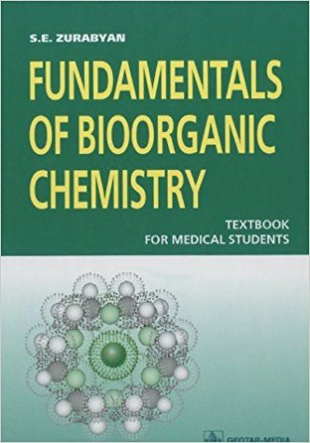
577.1
Z94
Zurabyan, S. E. Fundamentals Of Bioorganic Chemistry = Основы Биоорганической Химии - M. : Geotar-media, 2015.
The textbook is based on modern organic chemistry and considers the structure and chemical transformations of organic compounds, especially those that have biological importance. Special attention is given to the chemical reactions that have analogies in living systems. The book contains about 250 problems on all topics and solutions for them.
This book conforms to the Federal educational program on Bioorganic Chemistry for medi­cal schools and universities. It is meant for students who study Bioorganic Chemistry during one term. The book may also be useful for teachers and students of specialized secondary schools with instruction conducted in English and colleges, whose main interest is medicine, pharmacy, biology and agriculture.

Slide 5
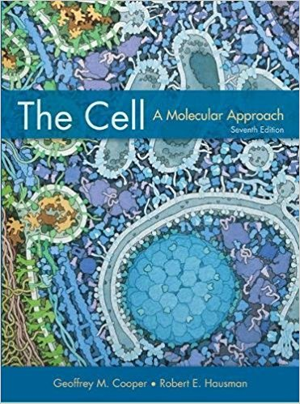
577.2
C77
Cooper, Geoffrey M. The Cell A Molecular Approach : Geoffrey M. Cooper, Robert E. Hausman. - 7th Ed. - U. S. A. : Boston University, 2016.
Teaching cell biology can be a daunting task because the field is so vast and rapidly moving, characterized by a continual explosion of new information. The challenge is how to teach students the fundamental concepts without becoming bogged down in details. Students need to understand the principles of cell biology and be able to appreciate new advances, rather than just memorizing "the facts" as we see them today. At the same time, the material must be presented in sufficient depth to thoughtfully engage students and provide a sound basis for

Slide 6
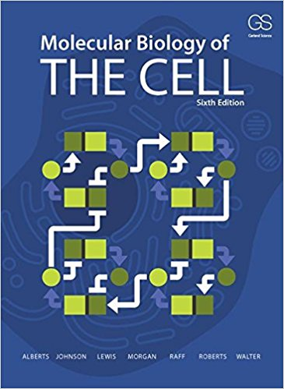
577.2
M79
Molecular Biology Of The Cell : B. Alberts [And Etc.]. - 6th Ed. - New York : Garland Science, 2015.
As the amount of information in biology expands dramatically, it becomes increasingly important for textbooks to distill the vast amount of scientific knowledge into concise principles and enduring concepts. As with previous editions, Molecular Biology of the Cell, Sixth Edition accomplishes this goal with clear writing and beautiful illustrations. The Sixth Edition has been extensively revised and updated with the latest research in the field of cell biology, and it provides an exceptional framework for teaching and learning.

Slide 7
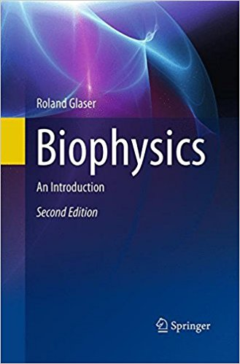
577.3
G51
Glaser, R. Biophysics. An Introduction : R. Glaser. - 2nd Ed. - Berlin : Springer-verlag, 2013.
Biophysics is the science of physical principles underlying all processes of life, including the dynamics and kinetics of biological systems.
This fully revised 2nd English edition is an introductory text that spans all steps of biological organization, from the molecular, to the organism level, as well as influences of environmental factors. In response to the enormous progress recently made, especially in theoretical and molecular biophysics, the author has updated the text, integrating new results and developments concerning protein folding and dynamics, molecular aspects of

Slide 8
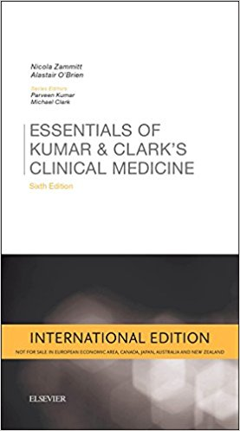
‘Baby Kumar & Clark’, best-selling portable revision reference, is now in its sixth edition
  61
  Z21
  Zammitt, N. Essentials Of Kumar Clarks Clinical Medicine : N. Zammitt, A. O Brien. - 6th Ed. - Philadelphia : Elsevier, 2018.

Slide 9
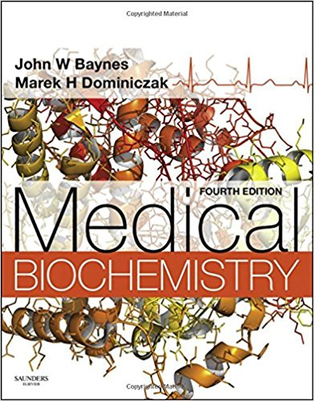
61
B33
Baynes, John W. Medical Biochemistry : John W. Baynes, Marek H. Dominiczak. - 4thed. - Philadelphia : Elsevier, 2014.
Brought to you in a thorough yet accessible manner, the new edition of Medical Biochemistry gives access to all of the latest information on basic and clinically focused genetic and molecular biology. Featuring a team of contributors that includes investigators involved in cutting-edge research as well as experienced clinicians, this updated medical textbook offers a unique combination of both research and practice that's ideal for today's problem-based integrated courses.

Slide 10
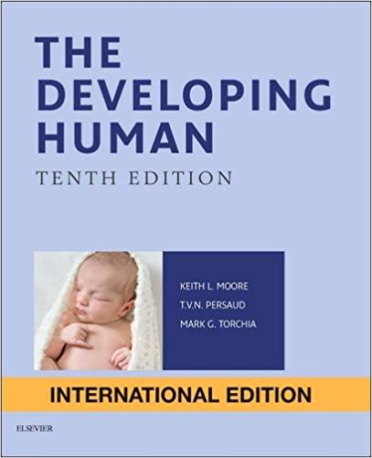
Written by some of the world's most famous anatomists, the 10th edition of The Developing Human: Clinically Oriented Embryology continues to present medical students with a comprehensive and easily digestible review of this complex topic. Clearly written and well-structured descriptions include just the information that's needed, while nearly 600 illustrations help provide a clinically oriented guide to human development, utilizing a week-by-week and stage-by-stage approach to describe fetal organ and system development.
611.013
M83
Moore, Keith L. The Developing Human. Clinically Oriented Embryology : Keith L. Moore, T. V. N. (Vid) Persaud, Mark G.Torchia. - Philadelphia : Elsevier, 2016.

Slide 11
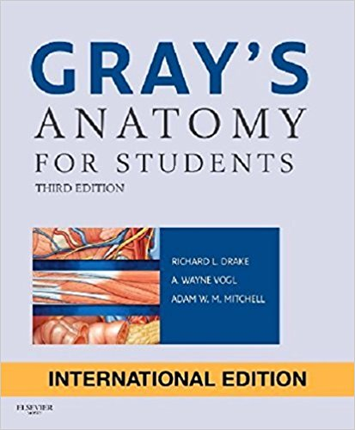
611
D80
Drake, Richard L. Gray" S Anatomy For Students : Richard L. Drake, A. Wayne Vogi, Adam W. M. Mitchell. - Philadelphia : Elsevier, 2015.
Anatomy texts just don't get any better than Gray's Anatomy for Students! Now in its 3rd edition, this completely revised medical textbook continues its focus on just the core information you need for your anatomy courses, presenting everything in an easy-to-read, visually appealing format that facilitates study.

Slide 12
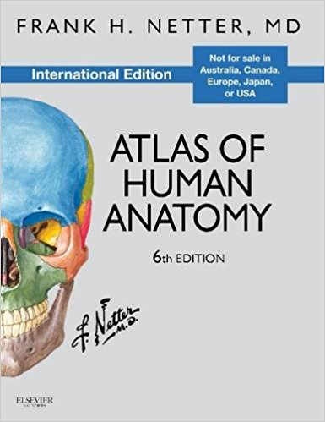
611
N47
Netter, Frank H. Atlas Of Human Anatomy : Frank H. Netter. - 6th Ed. - Philadelphia : Elsevier, 2014
The gold standard of excellence for 25 years, Frank H. Netter, MD's Atlas of Human Anatomy offers unsurpassed depictions of the human body in clear, brilliant detail - all from a clinician's perspective. With its emphasis on anatomic relationships and clinically relevant views, Dr. Netter's work provides a coherent, lasting visual vocabulary for understanding anatomy and how it applies to medicine today.

Slide 13
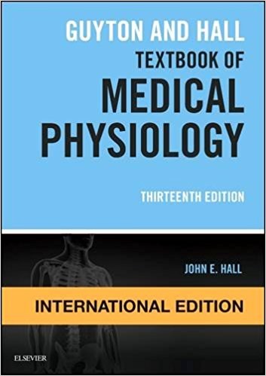
612
H19
Hall, John E. Guyton And Hall Textbook Of Medical Physiology: John E. Hall. - 13th Ed. - Philadelphia : Elsevier, 2016.
The 13th edition of Guyton and Hall Textbook of Medical Physiology continues this bestselling title's long tradition as the world's foremost medical physiology textbook. Unlike other textbooks on this topic, this clear and comprehensive guide has a consistent, single-author voice and focuses on the content most relevant to clinical and pre-clinical students. The detailed but lucid text is complemented by didactic illustrations that summarize key concepts in physiology and pathophysiology.

Slide 14
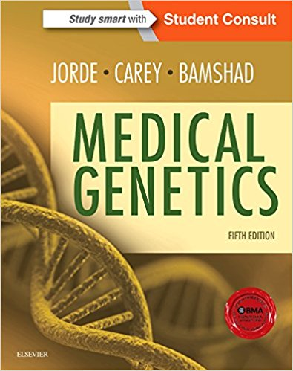
612.6.05
J77
Jorde, Lynn B. Medical Genetics : Lynn B. Jorde, John C. Carey, Michael J. Bamshad. - 5th Ed. - Philadelphia : Elsevier, 2016.
Popular for its highly visual, clinical approach, Medical Genetics delivers an accessible yet thorough understanding of this active and fast-changing field. Key updates in this new edition cover the latest developments which are integrated with clinical practice to emphasize the central principles and how they apply to practice. Photographs, illustrations, and tables, along with boxes containing patient/family vignettesdemonstrate clinical relevance and enhance visual impact of the material for easier and more effective

Slide 15
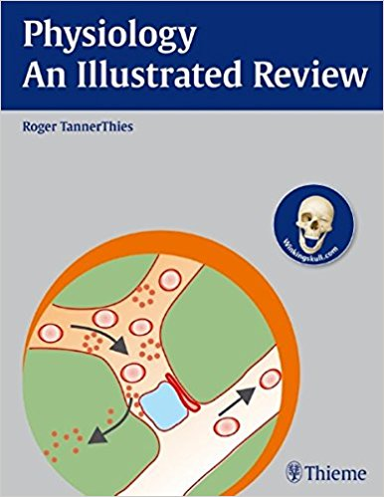
612.6.05
J77
Jorde, Lynn B. Medical Genetics : Lynn B. Jorde, John C. Carey, Michael J. Bamshad. - 5th Ed. - Philadelphia : Elsevier, 2016.
The perfect study tool for preparing for your courses or examinations - Physiology - An Illustrated Review's focused presentation and full-color illustrations makes learning the complex information essential to success easier. Sidebars make connections to underlying concepts in other basic sciences or apply the concepts presented in the clinical setting.

Slide 16
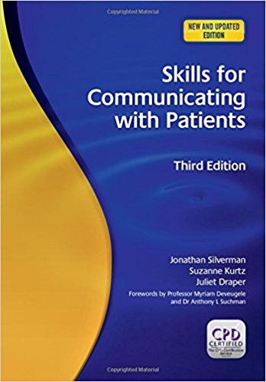
614.253
S-60
Silverman, J. Skills For Communicating With Patients : J. Silverman, S. Kurtz, J. Draper. - 3th Ed. - New York : CRC Press, 2014.
Skills for Communicating with Patients, Third Edition is one of two companion books on improving communication in medicine, which together provide a comprehensive approach to teaching and learning communication skills throughout all levels of medical education in both specialist and family medicine. Since their publication, the first edition of this book and its companion, Teaching and Learning Communication Skills in Medicine, have become established standard texts in communication skills teaching throughout the world.
This substantially expanded third edition has been fully updated in relation to the current literature and revis

Slide 17
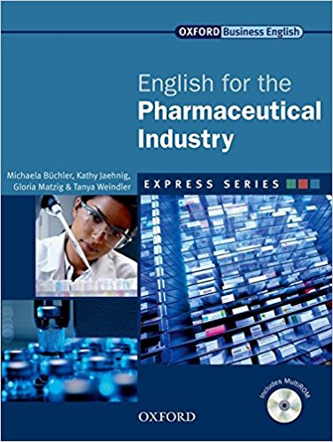
615.45
E56
English For The Pharmaceutical Industry : M. Bucheler - New York : Oxford University Press, 2014
English for the Pharmaceutical Industry is part of the Express Series. It is an ideal course for students in employment, who want to communicate better in English. This short, intensive course can be completed in 25-30 hours, so students make progress quickly. English for the Pharmaceutical Industry can be used as a stand-alone course, for self-study using the interactive MultiROM, or alongside a coursebook such as International Express.

Slide 18
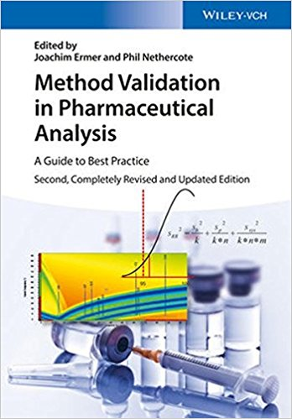
615.014
M61
Method Validation In Pharmaceutical Analisis : A Guide To Best Practice / Editors Dr. Joachim Ermer. - 2nd Ed. - Germany : Wiley-vch, 2015.
This second edition of a global bestseller has been completely redesigned and extensively rewritten to take into account the new Quality by Design (QbD) and lifecycle concepts in pharmaceutical manufacturing.
As in the first edition, the fundamental requirements for analytical method validation are covered, but the second edition describes how these are applied systematically throughout the entire analytical lifecycle. QbD principles

Slide 19
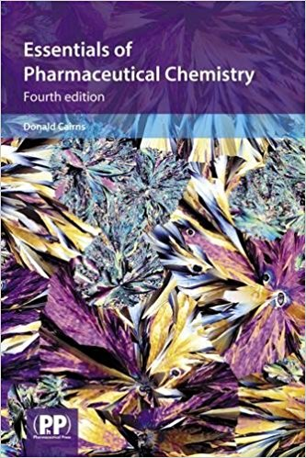
An introduction to pharmaceutical chemistry for undergraduate pharmacy, chemistry and medicinal chemistry students. Essentials of Pharmaceutical Chemistry is a chemistry introduction that covers all of the core material necessary to provide an understanding of the basic chemistry of drug molecules. Now a core text on many university courses, it contains numerous worked examples and problems. The 4th edition includes new chapters on Chromatographic Methods of Analysis, and Medicinal Chemistry - The Science of Drug Design.
615.014
C15
Cairns, D. Essentials Of Pharmaceutical Chemistry : D. Cairns. - 4th Ed. - London : [S. N.], 2013.

Slide 20
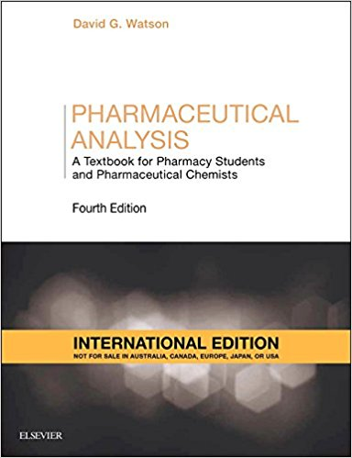
615.014
W32
Watson, David G. Pharmaceutical Analysis : A Textboor For Pharmacy Students And Pharmaceutical Chemists / David G. Watson. - 4th Ed. - Philadelphia : Elsevier, 2017.
Pharmaceutical analysis determines the purity, concentration, active compounds, shelf life, rate of absorption in the body, identity, stability, rate of release etc. of a drug. Testing a pharmaceutical product involves a variety of chemical, physical and microbiological analyses. It is reckoned that over GBP10 billion is spent annually in the UK alone on pharmaceutical analysis, and the analytical processes described in this book are used in industries as diverse

Slide 21

616.89
T27
Taylor, Shelley E. Health Psychology : Shelley E. Taylor. - 9thed. - Los Angeles : Mcgraw-hill, 2015.
Since the first edition was published in 1986, this textbook has helped thousands of college students learn how to maintain their health and guard against illness. The goal of the book has always been to make research accessible in a way that integrates theory with practical applications so that people can lead healthier lives. The importance of social relationships, health behaviors, and co-management of health and illness are themes that are woven throughout the text.

Slide 22
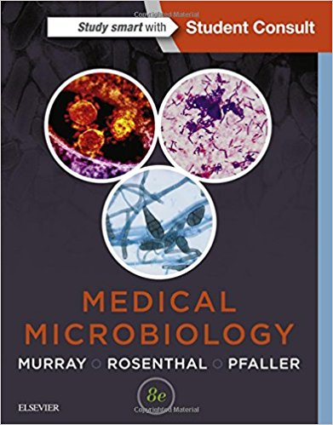
616-093/098
М96
Murray, Patrick R. Medical Microbiology : Patrick R. Murray, Ken S. Rosenthal, Michael A. Pfaller. - 8th Ed. - Philadelphia : Elsevier, 2016.
Turn To Medical Microbiology, 8th Edition For A Thorough, Clinically Relevant Understanding Of Microbes And Their Diseases. This Succinct, Easy-to-use Text Presents The Fundamentals Of Microbiology And Immunology In A Clearly Written, Engaging Manner―effectively Preparing You For Your Courses, Exams, And Beyond.
Coverage Of Basic Principles, Immunology, Laboratory Diagnosis, Bacteriology, Virology, Mycology, And Parasitology Help You Master The Essentials.

Slide 23
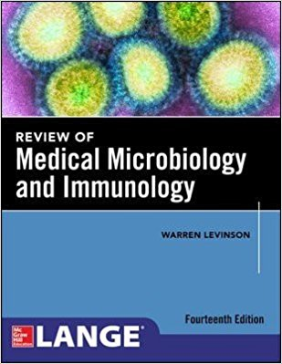
616-093/-098
L44
Levinson, Warren Review Medical Microbiology And Immunology : Warren Levinson. - New York : [S. N.], 2016.

Slide 24
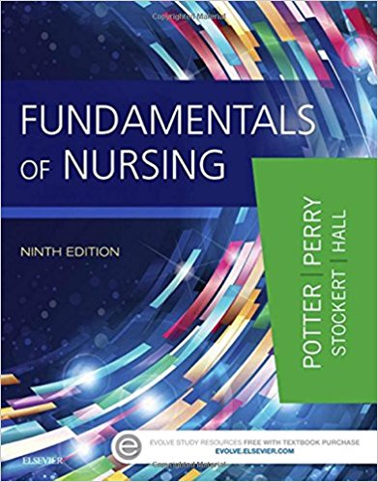
616-083
F97
Fundamentals Of Nursing : Patricia A. Potter [And Etc.]. - Philadelphia : Elsevier, 2017
It’s your complete guide to nursing ― from basic concepts to essential skills! Fundamentals of Nursing, 9th Edition prepares you to succeed as a nurse by providing a solid foundation in critical thinking, evidence-based practice, nursing theory, and safe clinical care in all settings. With illustrated, step-by-step guidelines, this book makes it easy to learn important skills and procedures. Care plans are presented within a nursing process framework, and case studies show how to apply concepts to nursing practice. From an expert author team led by Patricia Potter and

